Slide 1



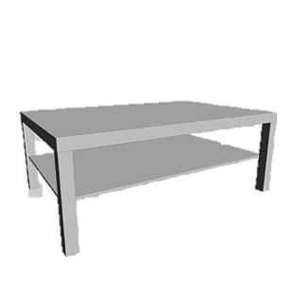
Studying Human Preferences in Human-robot Task Allocation
What does it mean?
I don’t prefer this task
Zahra Safari Dehnavi
Dr. Tamas Ruppert

Slide 2
Introduction
Task allocation is a fundamental challenge in human-robot collaboration (HRC).
Current methods often prioritize efficiency over human wellbeing.
Human factors approaches claim to design work systems fitting to human characteristics.
Human wellbeing can be inferred through self-reported preferences.
Incorporating human preferences into task allocation remains limited.
The role of individualized preferences in adaptive task distribution is largely unexplored.
This highlights a research gap in studying the underlying reasons for human preferences in task allocation.

Slide 3
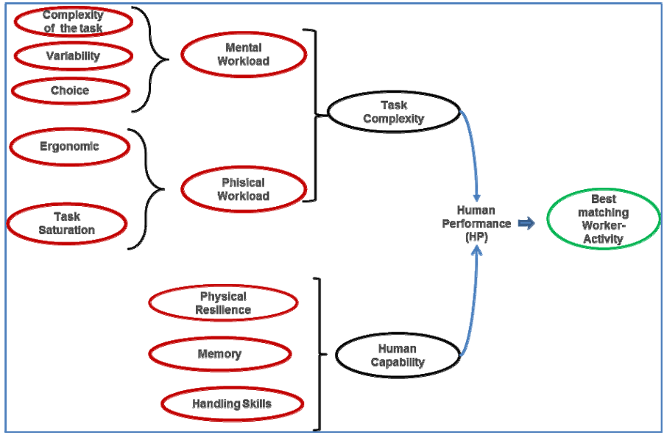
human capabilities matrix
Human performance depends on human capability and task complexity
For defining Task complexity: complexity, number of parts and tools, variability, effort
Human Factor Assessment in Assembly Line: an Operative Model

Slide 4
State of the art:
Several algorithms integrate human factors, such as cognitive/physical ergonomics and personal preferences, into task allocation, enhancing adaptability and well-being [1-3].
Christina’s work [4]:
Allowing participants to control task allocation increases their satisfaction and perceived competence.
Participants tend to prefer cognitive tasks for themselves and assign manual tasks to the robot.
Many studies suggest that preferences in decision-making arise from different cognitive and neural processes [5].
[1] M.C.Gombolay,R.A.Gutierrez,S.G.Clarke,G.F.Sturla,andJ.A.Shah, “Decision-making authority, team efficiency and human worker satisfac tion in mixed human–robot teams,” Auton Robot, vol. 39, pp. 293–312, 2015.
[2] M. Gombolay, A. Bair, C. Huang, and J. Shah, “Computational design of mixed-initiative human–robot teaming that considers human factors: situational awareness, workload, and workflow preferences,” Int. J. Robot. Res., vol. 36, no. 5–7, pp. 597–617, 20
[3] D. Dhungana et al., “Enabling resilient production through adaptive human-machine task sharing,” in Towards Sustainable Customization: Bridging Smart Products Manuf. Syst., A.-L. Andersen, Eds. Cham, Switzerland:Springer, 2022, pp. 198–206.
[4] Schmidbauer, C., Zafari, S., Hader, B., & Schlund, S. (2023). An empirical study on workers' preferences in human–robot task assignment in industrial assembly systems. IEEE Transactions on Human-Machine Systems, 53(2), 293-302.
[5] Evans, J. S. B. (2008). Dual-processing accounts of reasoning, judgment, and social cognition. Annu. Rev. Psychol., 59(1), 255-278.

Slide 5
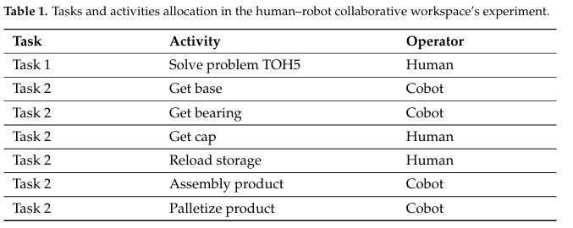
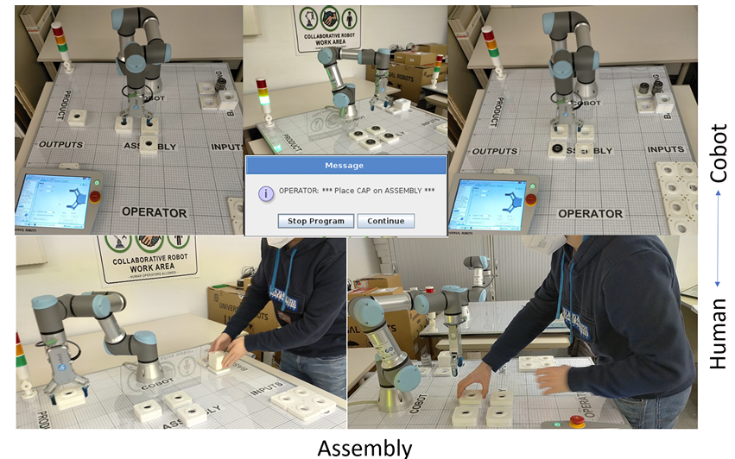
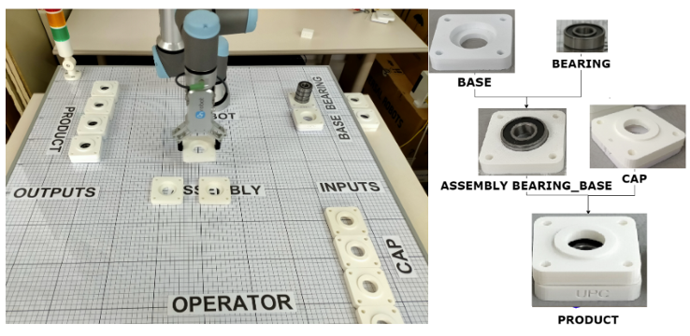
State of the art:
Article: Cognitive Interaction Analysis in Human–Robot Collaboration Using an Assembly Task
Use case: Assembly of a product composed of 3 components: a base, a bearing and a cap
Implementation:

Slide 6
Research Questions
To what extent do self-reported human preferences correlate with individual task-related capabilities in human-robot collaboration?
To what extent do human preferences correlate with their perception of robot capabilities in human-robot collaboration?
What factors (e.g., task difficulty, familiarity, trust in the robot) contribute to the formation of individual task preferences in HRC settings?

Slide 7
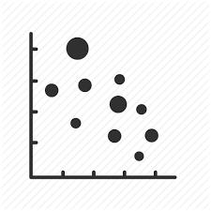
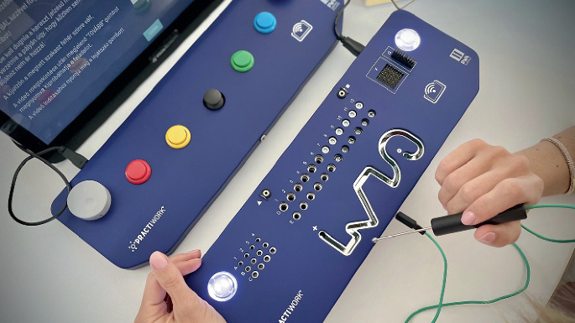


Study Setting
Design a human-robot collaboration scenario for a personalized assembly task.
Assess individual human capabilities prior to the collaboration.
Allow participants to self-allocate tasks between themselves and the robot.
Analyze the correlation/pattern between participants’ capabilities and their task allocation decisions.
Human will allocate the tasks
Post-questionnaire: Capability vs TA
Pattern?
Pre-questionnaire: Human capability and robot perception
Capability
Preference
Human Capability/skill:
Pick & Place
Screw
Palletizing
Quality check
Wire handling
….
Result?
Task allocation
$$\left[\begin{aligned}C1 \\ C2 \\ C3 \\ C4 \\ C5 \\ …\end{aligned}\right]$$
$$\left[\begin{aligned}T1→h \\ T2→r \\ T3→r \\ T4→h \\ T5→h \\ …\end{aligned}\right]$$

Slide 8
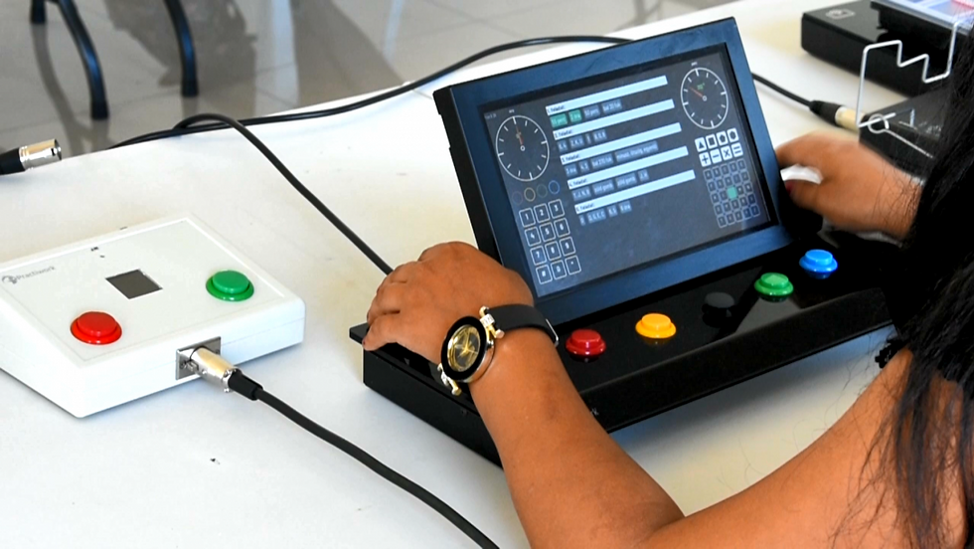

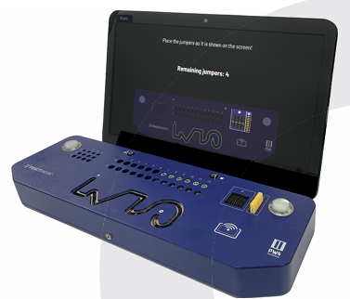
Practiwork
Developing employee evaluation systems, including: Developing a performance assessment system; Providing consultancy on performance assessment.
Assessment:
Reasoning
Psychometric: e.g. Hand dexterity, hand stability
~ 15 min experiment

Slide 9
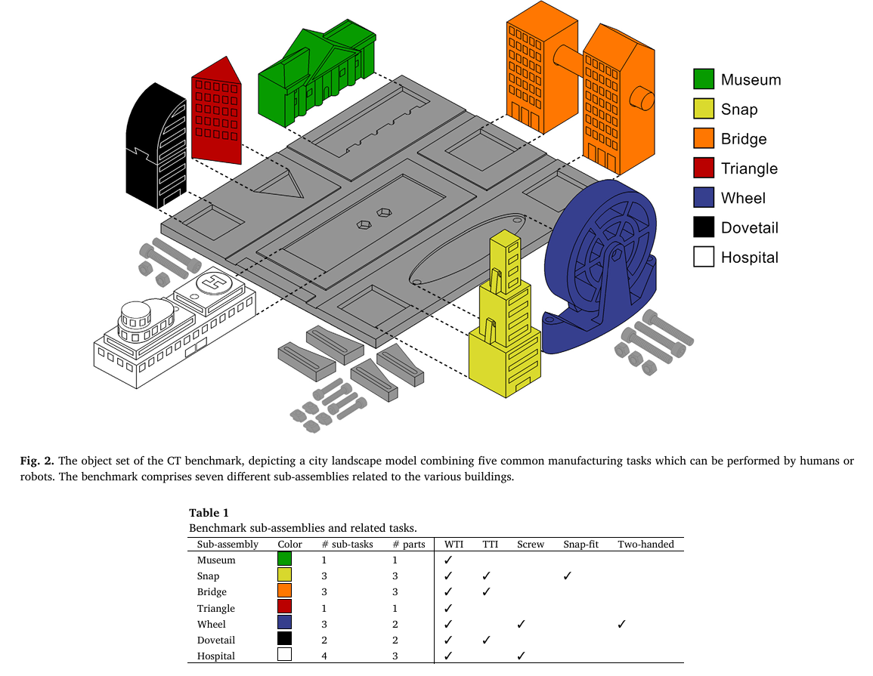
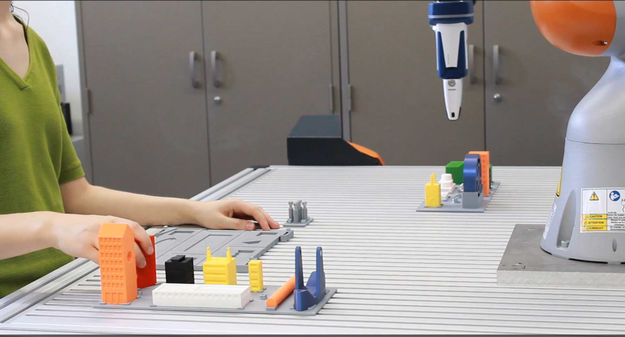
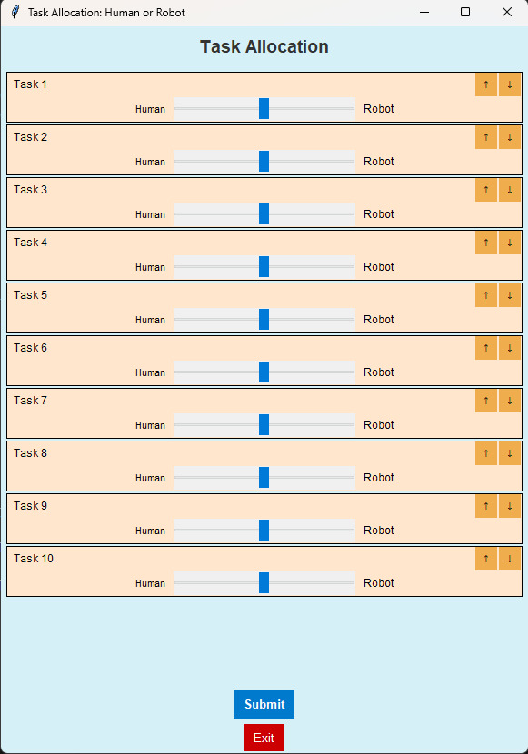
Study Design
A human-robot collaboration scenario for a personalized assembly task ~60 min
Skill assessment ~15min : Practiwork
Familiarization ~10 min: Observing the robot perform the task three times as a learning phase
→ general attitude toward robots
Human Trials ~10 min: only human perform the assembly 3X → followed by Nasa-TLX
TA trials ~10min: human trying the TA 3X
Test under time pressure→ Followed by Nasa-TLX, general attitude toward robots, SUS
wide tolerance insertions (WTI),
the tight tolerance insertion (TTI),
screw fastening,
snap fitting and
two-handed actions.
Benchmarking human-robot collaborative assembly tasks

Slide 10
Updated Experiment:
Training session : Play with robot and assembly task
Self Assessment: General Self-Efficacy Scale
Robot Assessment: GAToRS — General Attitudes Towards Robots Scale
Training session: with TA
Experiment1: Allocate tasks between themselves and robot
Questionnaire: Nasa-tlx
Experiment2: + Cognitive load: Users will get some simple math problems every minute and without solving they can not continue, They allocate the tasks to themselves and robot
Questionnaire: Nasa-tlx + cognitive questionnaire
Final Qualitative questions:

Slide 11
Expected Outcome
Identification of patterns linking human capabilities to their task preferences.
Discovery of correlations between perceived robot capabilities and human task preferences.
Recognition of additional influencing factors (e.g., task difficulty, familiarity, trust in the robot) that shape individual preferences.
Insights into variability of preferences across individuals with similar capabilities.

Slide 12

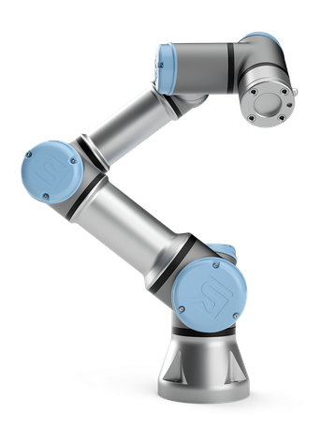
Zahra Todos
Buy screws- OBI
Connect interface with the robot_ bring the adapter from pilotfactory
Prepare the steps and the environment
Finalize the code with exact movements

Slide 13
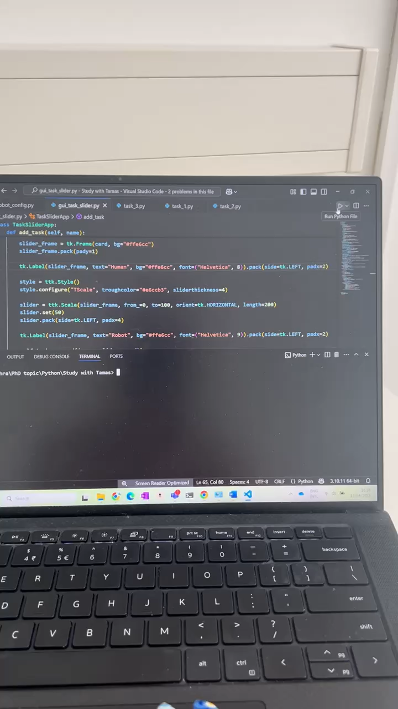
First try:
acc = 0.4
vel = 0.5

Slide 14
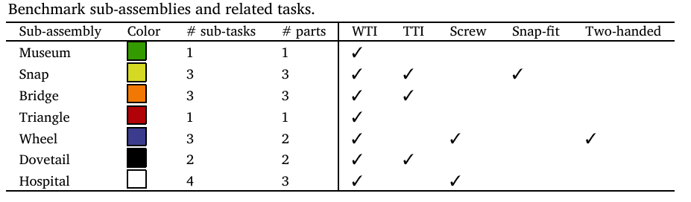
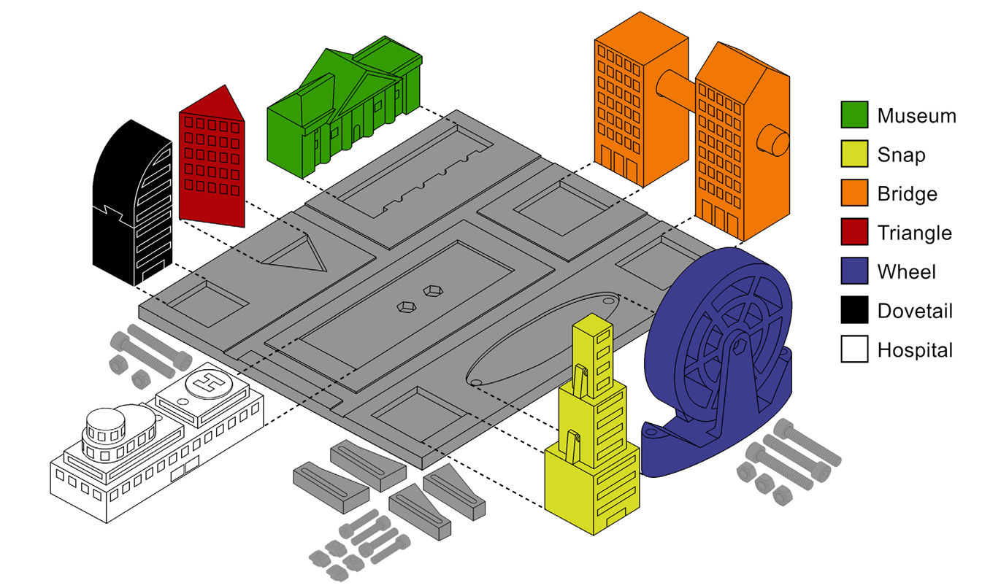
Experiment:
Task | Parts | Type | Agent | Dependency | Robot_time
1 | Museum | W_PP |  | 0
2 | Triangle | W_PP |  | 0
3 | Snap_base | W_PP |  | 0
4 | Snap_middle | Snap |  | 1
5 | Snap_top | Snap |  | 2
6 | Wheel_base | W_PP |  | 0
7 | Wheel_b_screw | screw |  | 1
8 | Wheel | T_PP |  | 1
9 | Wheel_screw | Screw | Only H? | 2
10 | Bridge_home | W_PP |  | 0
11 | Bridge_home2 | W_PP |  | 0
12 | Bridge_rod | T_PP |  | 2
13 | Dovetail_base | W_PP |  | 0
14 | Dovetail_top | T_PP |  | 1
15 | Hospital_base | W_PP |  | 0
16 | Hospital_H | T_PP |  | 1
17 | Hospital_top | T_PP |  | 1
18 | Hospital_screw | Screw | Only H? | 3
Based on the paper, total time of assembly for
Only human: 120 seconds
Collaboration: 205 seconds
Only robot: 419 seconds

Slide 15
Experiment:
First set
Second set
Task | Parts | Type | Agent
1 | Museum | W_PP
2 | Triangle | W_PP
3 | Snap_base | W_PP
4 | Snap_middle | Snap
5 | Snap_top | Snap
6 | Wheel_base | W_PP
7 | Wheel_b_screw | screw
8 | Wheel | T_PP
9 | Wheel_screw | Screw | Only H?
10 | Bridge_home | W_PP
11 | Bridge_home2 | W_PP
12 | Bridge_rod | T_PP
13 | Dovetail_base | W_PP
14 | Dovetail_top | T_PP
15 | Hospital_base | W_PP
16 | Hospital_H | T_PP
17 | Hospital_top | T_PP
18 | Hospital_screw | Screw | Only H?
Task | Parts
1 | Museum
2 | Triangle
3 | Snap_base
4 | Snap_middle
5 | Snap_top
6 | Wheel_base
7 | Wheel_b_screw
8 | Wheel
9 | Wheel_screw
10 | Bridge_home
11 | Bridge_home2
12 | Bridge_rod
13 | Dovetail_base
14 | Dovetail_top
15 | Hospital_base
16 | Hospital_H
17 | Hospital_top
18 | Hospital_screw
Reminder: the goal is to map human capabilities to the TA, in which tasks the robot is better that causes the human to allocate tasks to it?
We can also offer them that the system do the task allocation…
A mapping should be done for the robot programming

